Slide 1
Ionic Bonds: Naming & Writing

Slide 2
Intro Questions
MODEL
Reviewing the Model
1. What does the subscript 2 indicate in Cl₂?
2. What is implied when there is no subscript?
3. Classify C, Fe and Cl as metals or nonmetals.
Fe
C
Cl₂
FeCl₃
CCl₄

Slide 3
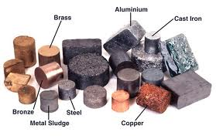
What we know
Metals on left of P.T., nonmetals on right
Metals want to lose electrons, become positive
Non-metals want to gain electrons, become negative
Metals: form cations
Non-metals: form anions,

Slide 4
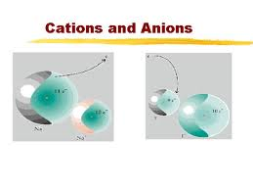
Ionic Bond
Occurs between a metal and a non-metal
Metal gives up electrons, non-metal accepts electrons; electrons are transferred!
Both elements now have a complete octet!
The metal, now with a + charge is attracted to the non-metal, which has a – charge!
Forms an ionic compound!

Slide 5
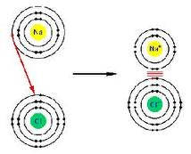
Ionic Bonding

Slide 6
Writing Ionic Formulas: Criss-Cross Method
Note: Charges must add up to ZERO!
Steps:
Write symbols for compound out: cation first, then anion
Write charges above each element
Cross charges below opposite element, removing “+” or “–”
Reduce if necessary
Check to ensure charges = 0

Slide 7
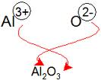
Criss Cross Example
Aluminum Oxide:

Slide 8
Writing Ionic Formulas: Criss Cross
Practice:
Sodium Chloride
Magnesium Iodide
Lithium Sulfide
Potassium Nitride
Beryllium Oxide
Aluminum Oxide
Aluminum Nitride

Slide 9
Naming Ionic Compounds
Steps
List Cation first, then anion
Cation: name does not change
Anion: drop the ending (usually last three letters), and add -ide
Ex: Fluorine = fluoride
Ex: oxygen = oxide

Slide 10
Naming Compounds: Transition Metals
Note: Many transition metals can have multiple charges. (Pb and Sn also)
Iron: can have charge of +2 or +3
In order to specify what the charge is, we use roman numerals in parentheses after the cation
Ex: Iron (II) Oxide
Ex: Iron (III) Oxide
*You will need to use anion to determine the charge of cation if it is a transition metal!

Slide 11
Naming Practice
Practice
MgCl₂
BaO
Cs₃N
Fe₂0₃
VBr₅
CuN
ZnO
PbS₂ (treat Pb as a transition metal)

