Slide 1
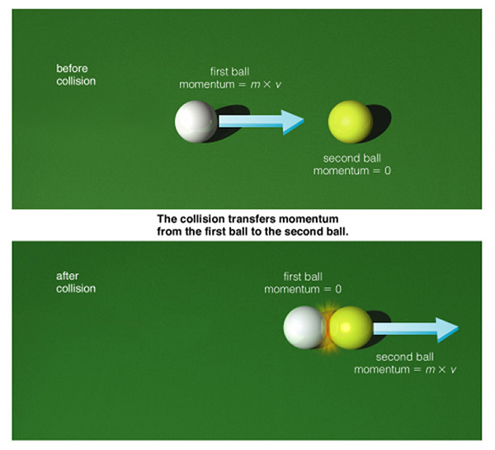
Conservation of Momentum

Slide 2
What We Know
Momentum is calculated p = mv
Impulse is any change in momentum, requires a force and time
The greater the Force in a change of momentum, the less time it requires
Ft = mv_{f} –mv_{i}
Δp = F * Δt
Δp = mv_{f} – mv_{i}

Slide 3
Conservation of Momentum
When two objects come into contact with each other, the total momentum of both objects before the collision must be equal to total momentum of both objects after collision!
p_{before} = p_{after}
(p = momentum)

Slide 4
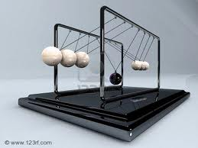
Examples of Conservation
Jumping on Surface of earth.
Basketball and Tennis Ball
Two people on rollerblades pushing off each other.
Newton’s Cradle

Slide 5
Conservation of Momentum
If one of the objects loses momentum in collision, the other objects will gain the same amount of momentum that was lost!
Before Collision: Car A has a momentum of 5 kg.m/s, Car B has a momentum of 10 kg.m/s. After the collision, Car A has a momentum of 12 kg.m/s, what is the momentum of Car B?

Slide 6
Conservation of Momentum
m₁v_{1i} + m₂v_{2i} = m₁v_{1f} + m₂v_{2f}
m₁ = mass of 1st object
m₂ = mass of 2nd object
v_{1i} = initial velocity of 1st object
v_{2i} = initial velocity of 2nd object
v_{1f} = final velocity of 1st object
v_{2f} = final velocity of 2nd object

Slide 7
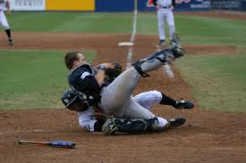
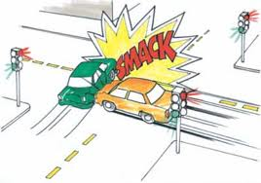
Collision Types
When objects collide, there are 3 possible outcomes.
Objects hit and stick together (inelastic collision)
Objects hit and bounce off (elastic collision)
1 object splits in 2 (separation)

Slide 8
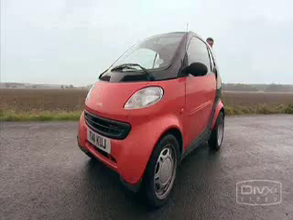
Inelastic Collision
Object hit and stick together
2 objects before
1 object after
Final mass = (m₁ + m₂)
Same final v for each

Slide 9
Elastic Collision
Objects hit and bounce off each other
2 objects before
2 objects after
Each velocity has a different value

Slide 10
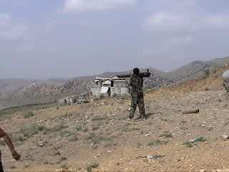
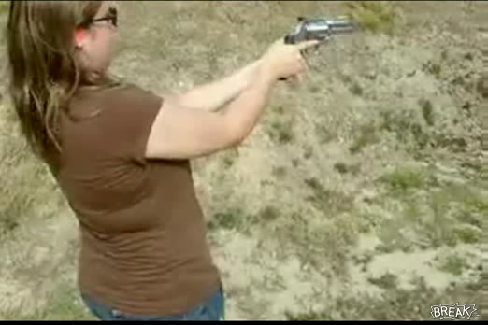
Separation
Object splits apart
1 object before
2 objects after
Initial mass = (m₁ + m₂)
Initial v = 0 (most cases)
http://dsc.discovery.com/videos/mythbusters-leather-cannon-angle-3.html

Slide 11
Problem Solving Steps
Remember: velocity and momentum are vectors, they require a direction!
Determine if objects start together or apart, and if then if the objects end together or apart.
Calculate momentum of each object before the collision
Add these p’s together to find p_{total} (= p_{after})
Calculate mass after the collision.
Calculate the velocities after collision.

Slide 12
Practice Problem #1
A 75 kg boy is sprinting at 2.3 m/s east because he is late to class. The boy collides head on with a 50.0 kg girl who is walking with a velocity of 0.75 m/s west. After the collision the boy has a velocity of 1.2 m/s east. What is her velocity after the collision?
(75kg)(+2.3m/s) + (50.0kg)(-.75m/s) = (75kg)(+1.2m/s) + (50.0kg)(V_{f})
Vf girl = +.90 m/s

Slide 13
Practice Problem #2
A 110 kg stationary goalie (on ice skates) catches a 2.2 kg hockey puck traveling at +45 m/s. At what velocity will the goalie and the hockey puck move after the collision?
(110kg)(0m/s) + (2.2kg)(+45m/s) = (112kg)(Vf)
Vf = +0.88 m/s

Slide 14
Practice #3
A 2500 kg boulder falls towards earth, colliding with earth at an impact velocity of -98 m/s. If the mass of the earth is 5.97 X 10²⁴ kg, what will be the velocity of the earth and the boulder after impact?
(2500kg)(-98m/s) + (5.97 X 10²⁴ kg)(0m/s) = (5.97 X 10²⁴ kg)(Vf)
Vf = -4.1 x 10⁻²⁰ m/s

Slide 15
Practice #4
A boy (30.0 kg) stands at rest on roller skates. He is holding a 5.5 kg cinder block. He throws the cinder block forward, causing him to move backwards at 1.6 m/s. What velocity did he throw the cinder block with?
(0kg*m/s)=(30.0kg)(-1.6m/s) + (5.5kg)(Vf)
Vf = +8.7 m/s

